Slide 1
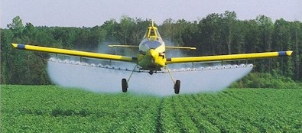
Ag Spraying / Seeding
Control of pest weeds and insects is important to agriculture production in South Dakota.

Slide 2
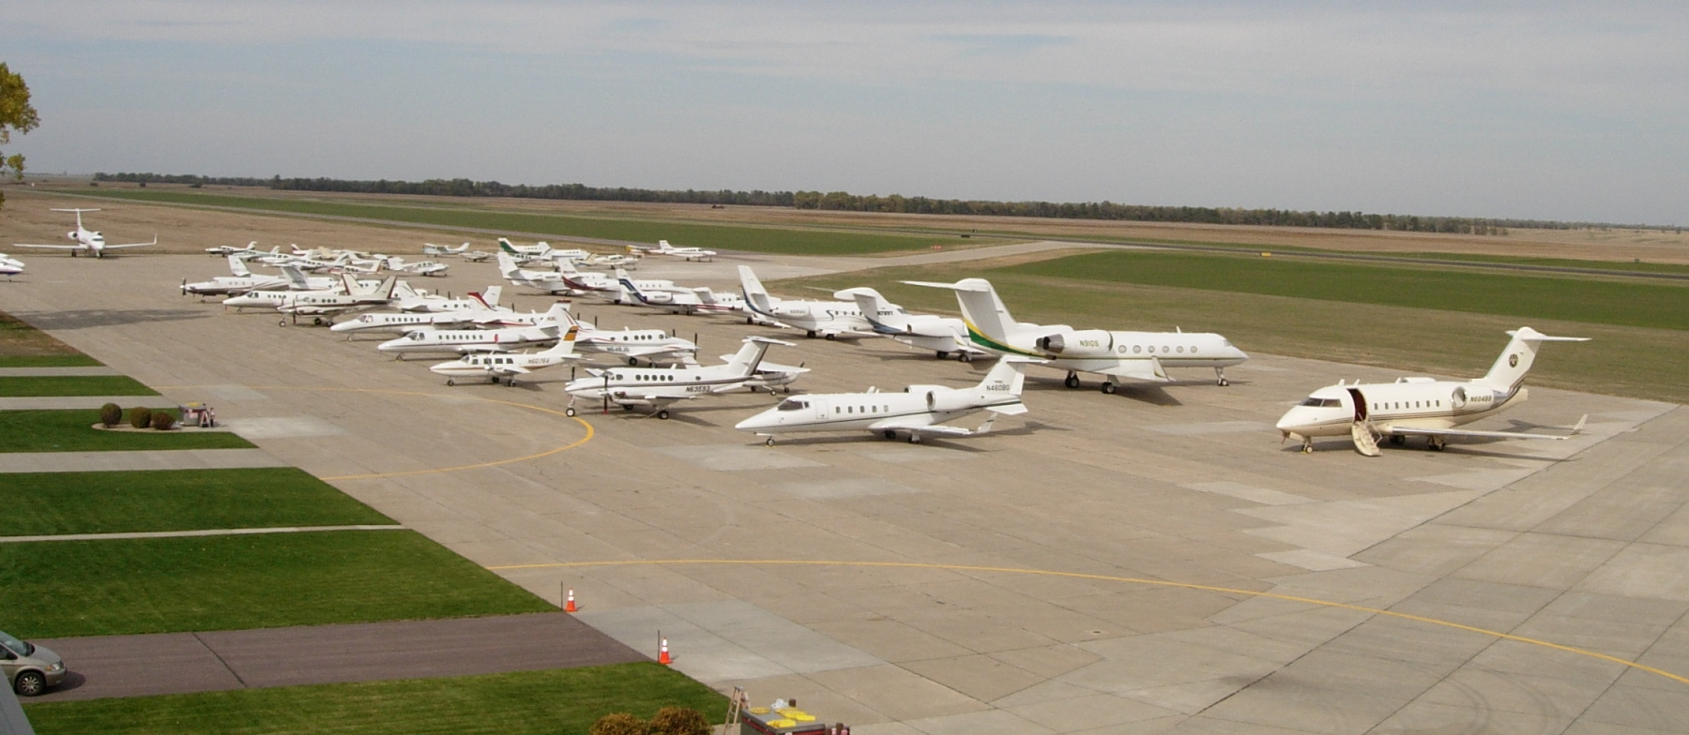
Hunting
Opening day of pheasant season brings flocks of planes, hunters, and dogs to South Dakota (Mitchell Airport).

Slide 3
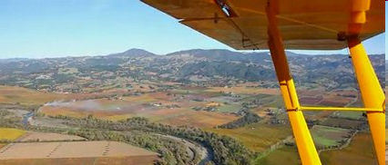
Farming / Ranching
Aircraft are tools for checking crops, livestock, water tanks & windmills, and more in South Dakota.

Slide 4
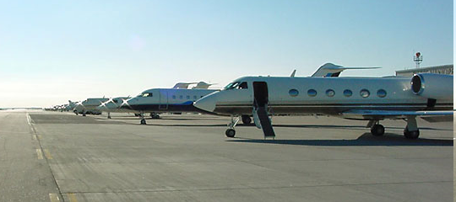
Business
Business travel is important to economic development in South Dakota (Pierre Airport).

Slide 5
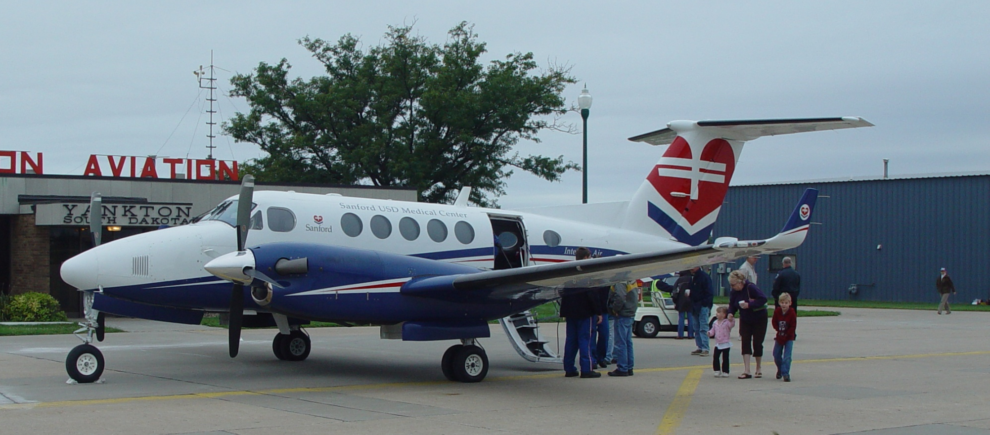
Air Ambulance
Air ambulances (fixed wing & rotary wing) carry medical patients among facilities (Chan Gurney Airport).

Slide 6
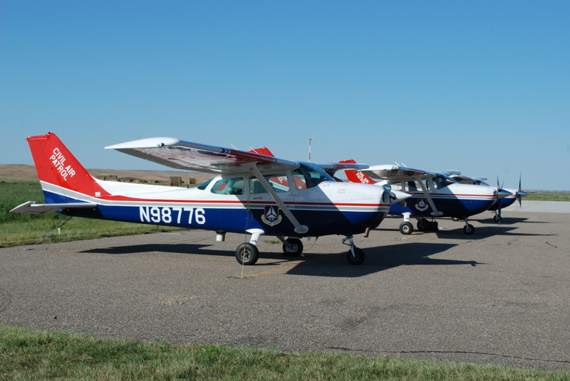
Search & Rescue
SD Civil Air Patrol conducts search and rescue, wildlife surveys, fire spotting, and more in South Dakota.

Slide 7
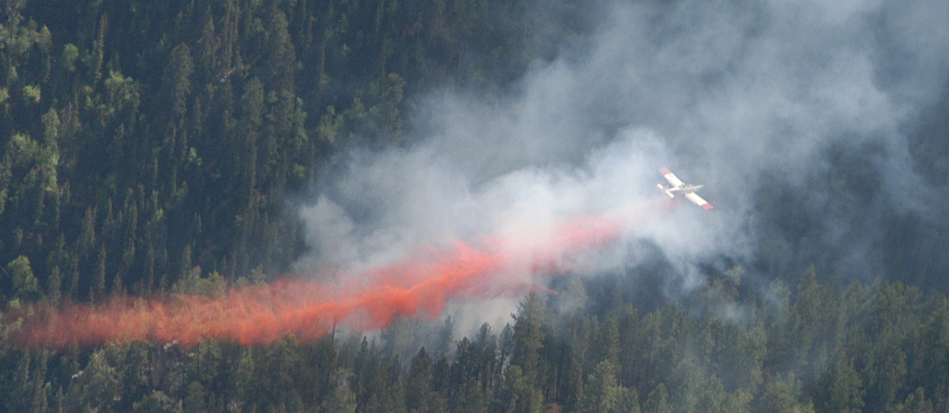
Fire-Fighting
SD Division of Wildland Fire Suppression protects resources (Spearfish Canyon: photo by SD CAP).

Slide 8

Tourism
Flight seeing of the Black Hills, Cathedral Spires, Harney Peak, Crazy Horse, Mt. Rushmore, Badlands, more.

Slide 9
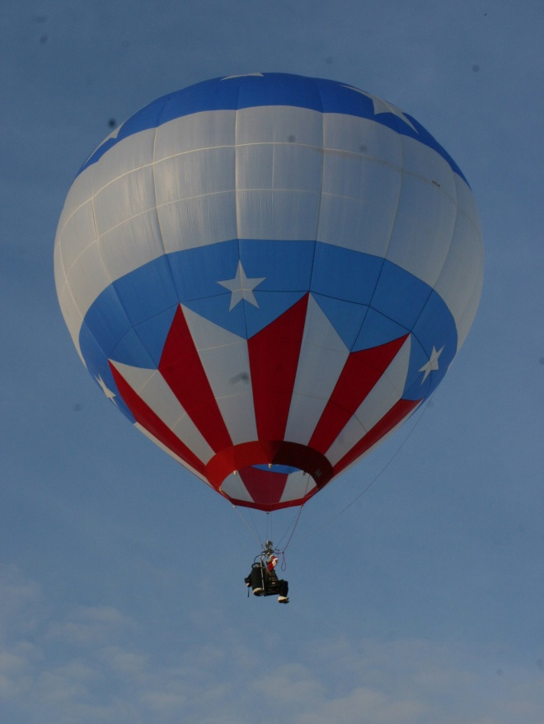
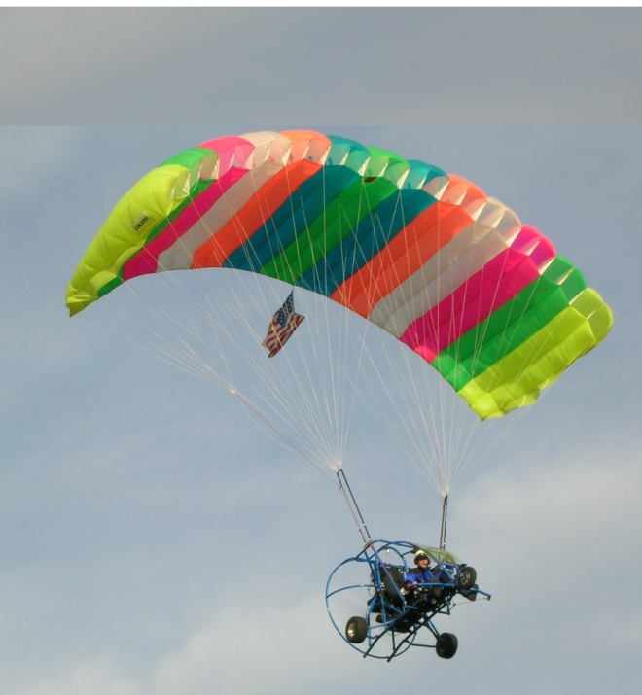
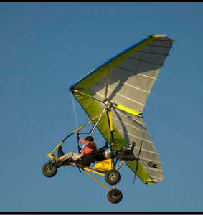
Recreation
Recreational aircraft are a fun alternative to boats, ATVs, bikes, motorcycles, snowmobiles, etc.

Slide 10
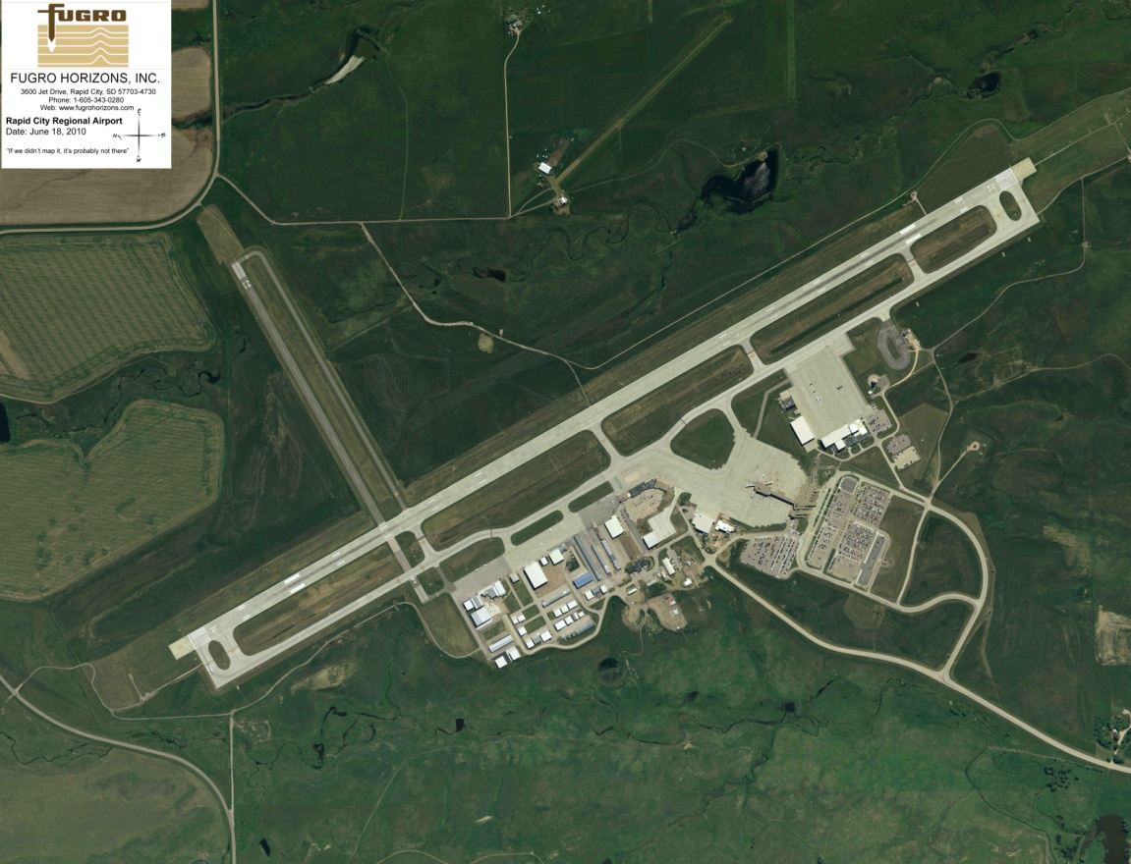
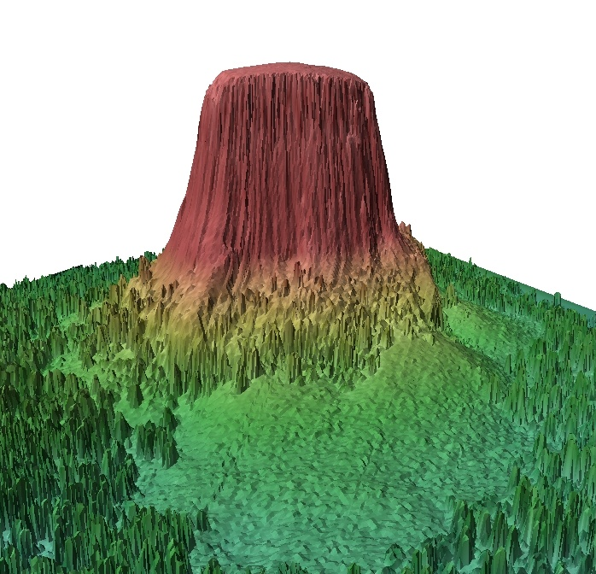
Aerial Mapping
Aerial photography & digital mapping products aid private, state, and federal with information for development.

Slide 11
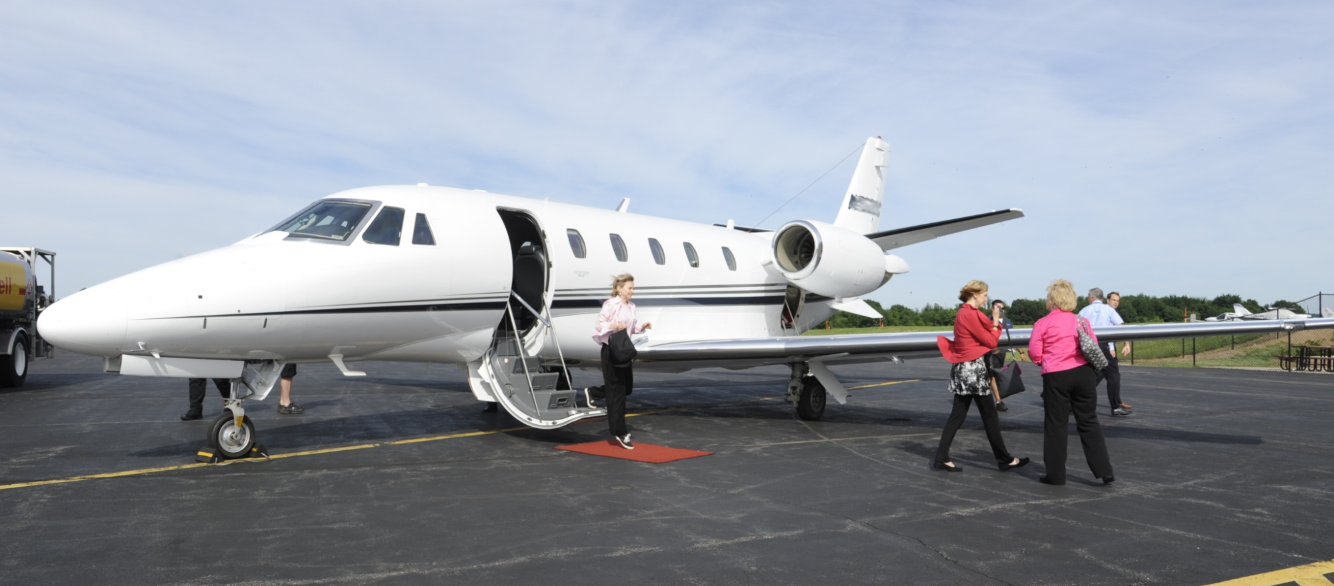
Air Taxi / Charter
Transporting individuals via small plane can be more economical & faster than airline service (Sioux Falls).

Slide 12
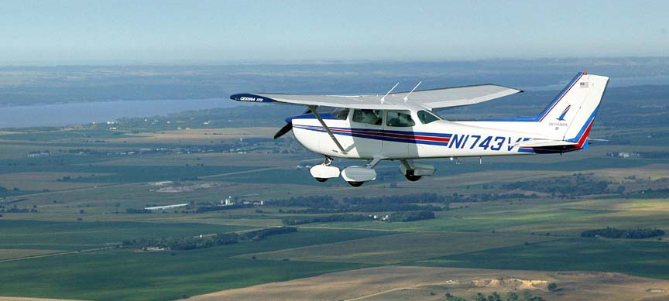
Flight Instruction
Learning to fly is a pre-requisite to many careers in aviation and aerospace.

Slide 13
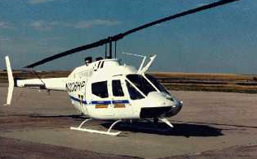
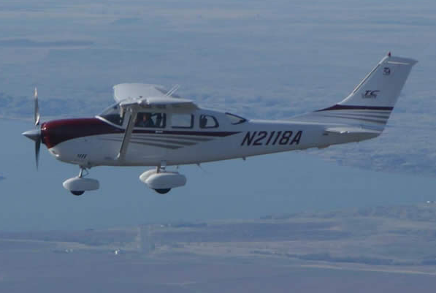
Law Enforcement
Aircraft (rotary wing & fixed wing) are important tools in law enforcement.

Slide 14
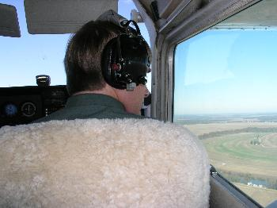
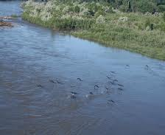
Fish & Wildlife Management
Aircraft assist in the management of fish and wildlife populations and monitoring of endangered species.

Slide 15
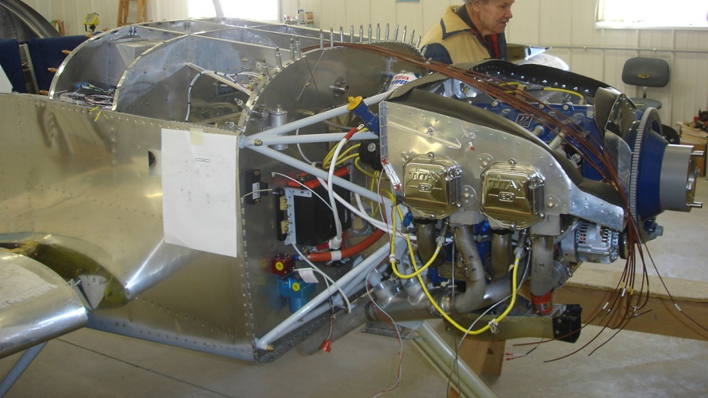
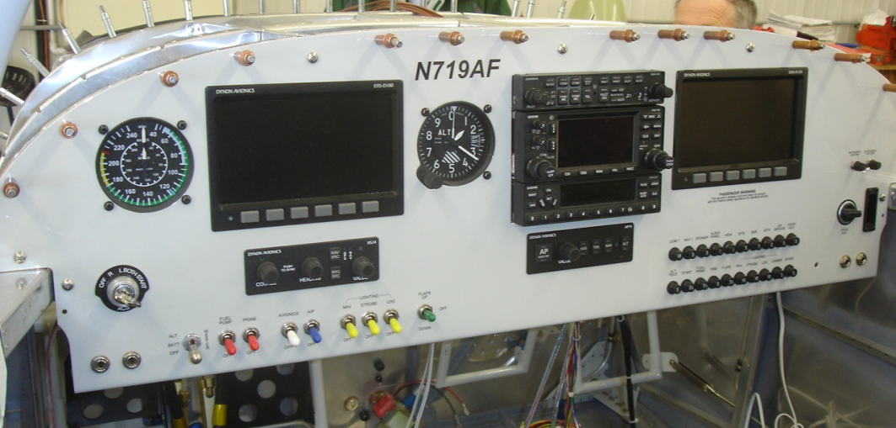
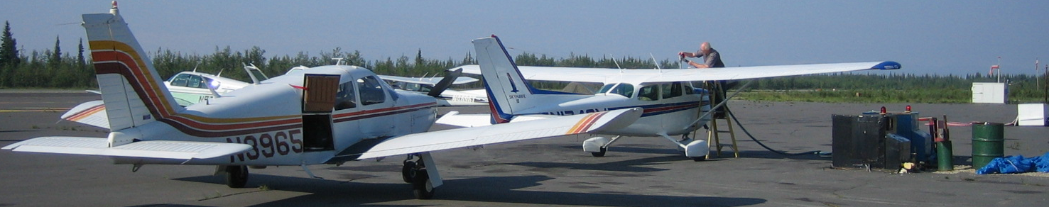
Jobs
General aviation provides jobs for fixed based operations, maintenance, avionics, fueling, manufacturing, and more.

Slide 16






Service Organizations
Service organizations provide support for communities.

Slide 17
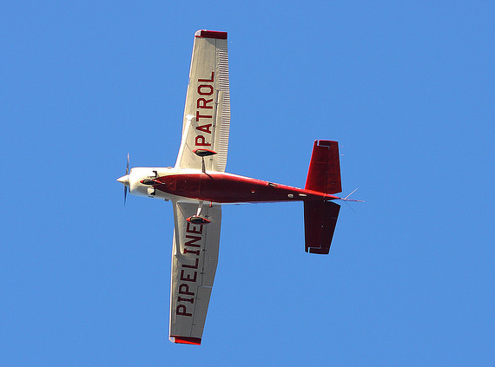
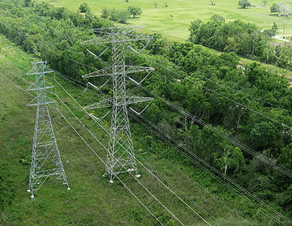
Pipeline Patrol
Pipeline Patrol flights monitor the condition of power transmission lines and oil, gas & water pipelines.

Slide 18
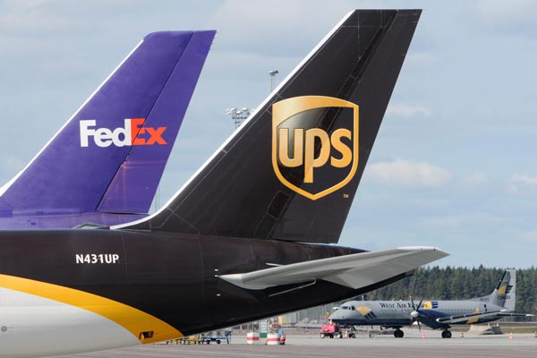
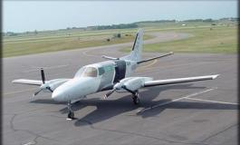
Cargo & Freight Hauling
Timely cargo & freight hauling, whether big or small, is essential to efficient business operations.

Slide 19
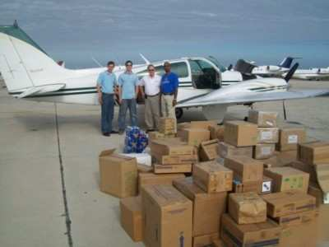
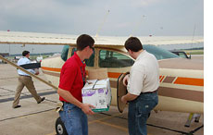
Disaster Relief
Small aircraft provide quick, critically important disaster relief in response to emergencies.

Slide 20
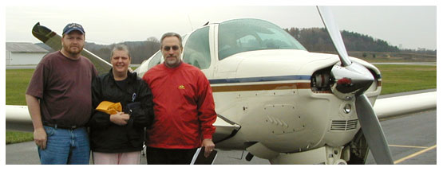
Humanitarian Assistance
Angel Flight LifeLine Pilots Air Care Alliance Mercy Flight Freedom Flight Lighthawk PAWS (many more)
General aviation provided timely & charitable transportation for patients, families, and other causes.

Slide 21
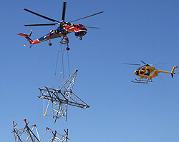
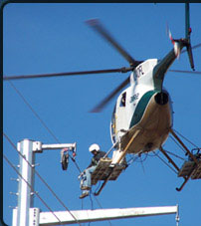
Construction
Helicopters are efficient at addressing unusual construction and maintenance needs.

